Slide 1


EE599 Final Project
Trojanmap Group name: RUNTIME TERROR
Name: Rohit Singh(rksingh@usc.edu),
Kunal Sheth(kunalche@usc.edu)

Slide 2
Introduction
Auto Complete - Rohit/ 3
Get Position - Kunal / 4
Shortest Path Dijkstra –Rohit / 5
Shortest Path Bellman Ford –Rohit / 8
Travelling Trojan Algorithm –Kunal, Rohit/ 6
1
2
3
4
5
|
6
contents

Slide 3
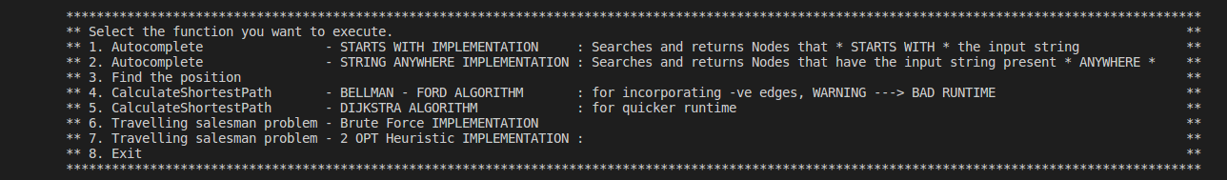
Main MENU
Modifying the Menu to incorporate all the helper functions
Modified the code for user adaptability.

Slide 4
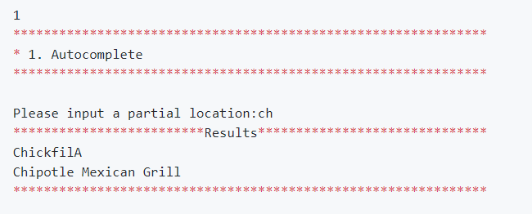
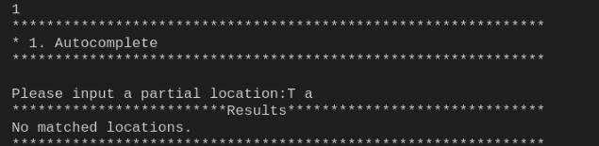
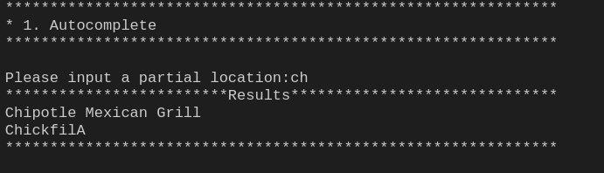
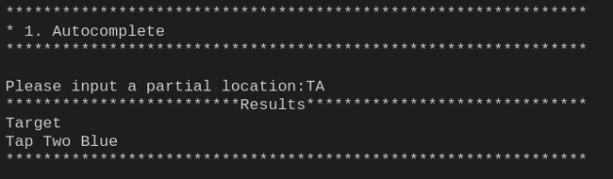
AUTO COMPLETE
Generating all the possible Nodes, according to the partial search data
Case Sensitivity
Starts With
Time complexity: O(n)
Corner Cases

Slide 5
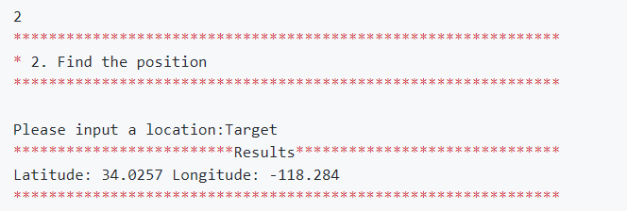
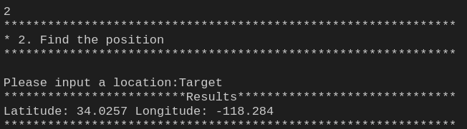
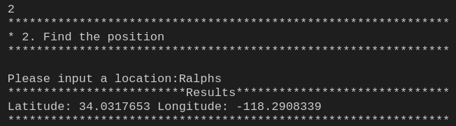
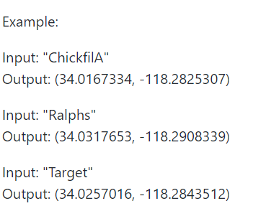
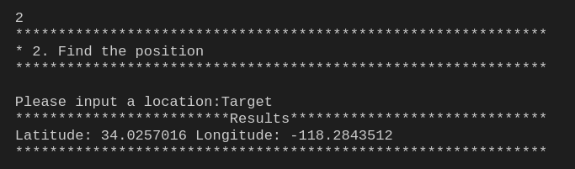
Get Position
Returning Position (Latitude and Longitude) for a given Nodes
Matches exact Output mentioned
Runtime : O(logn)
Corner Cases

Slide 6
Shortest Path algorithm(Dijkstra’s Algorithm)
Min heap implementation helped to get the shortest path in a greedy manner, because in each step we pick the vertex with minimum distance from current vertex.
Time Complexity: O(v^2)
Comparison with google maps(next slide)

Slide 7
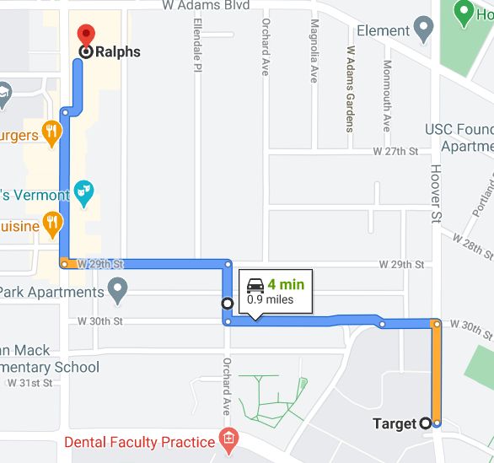
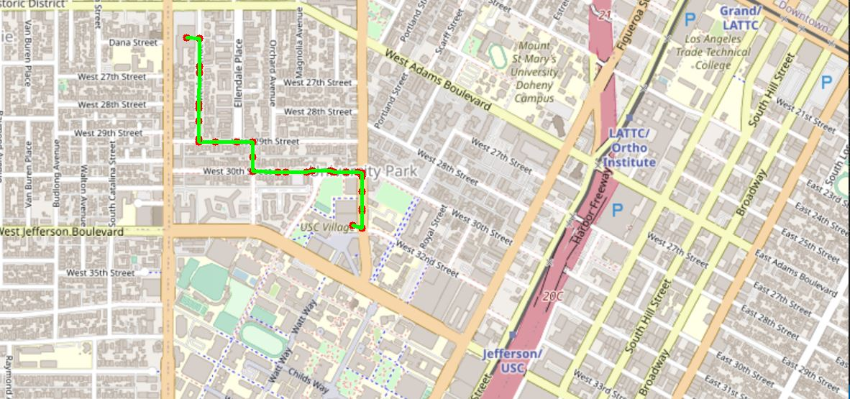
Shortest Path algorithm(Comparison with google maps)
Implementing Djikstra Algorithm
Input -> Target Output -> Ralphs

Slide 8
Shortest Path algorithm(BELLMAN FORD’s Algorithm)
Recursive algorithm iterating all the edges in the graph.
Time Complexity: O(m*n)
Graph generated is like that of Dijkstra’s.

Slide 9
TRAVELLING Trojan (Brute force - DFS)
Returning Position (Latitude and Longitude) for a given Nodes
In this method we try each and every possible permutations.
Further, whenever the current path length is larger than the current optimal result, we need to return
Graph data structure is used, and that graph is a cyclic one meaning that the starting point and the ending point is the same. Note, any point can be selected as a starting point.
Finally after calculating the weight, we return the most minimum weight of all.
Time complexity: O(n!)
Not good for large data sets as the time to execute the code is very large

Slide 10
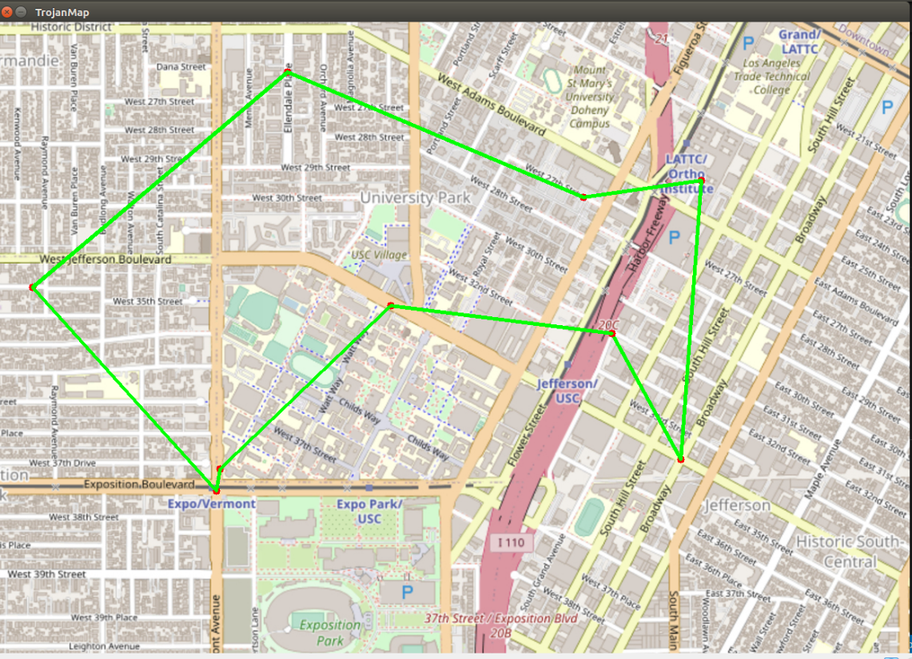
TRAVELLING Trojan (Output - Brute force - DFS)
Returning Position (Latitude and Longitude) for a given Nodes
Below is one such output from our implementation with the number of locations as ‘9’.

Slide 11
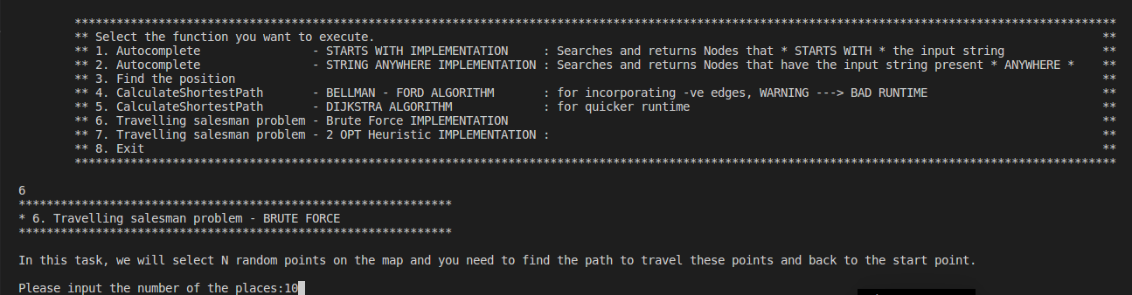
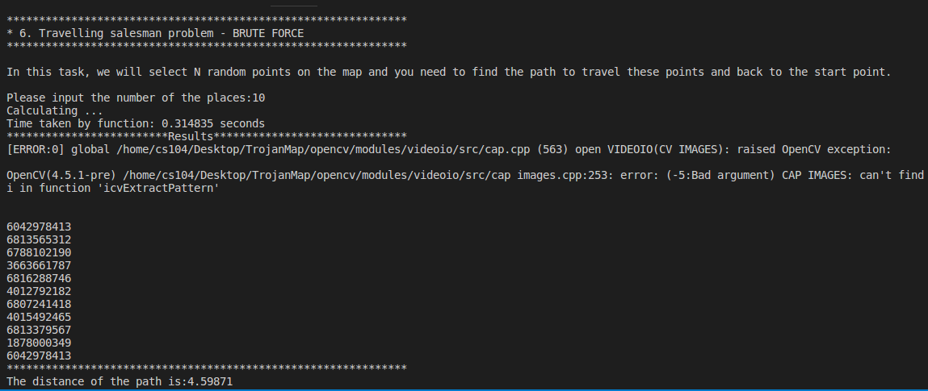

Slide 12
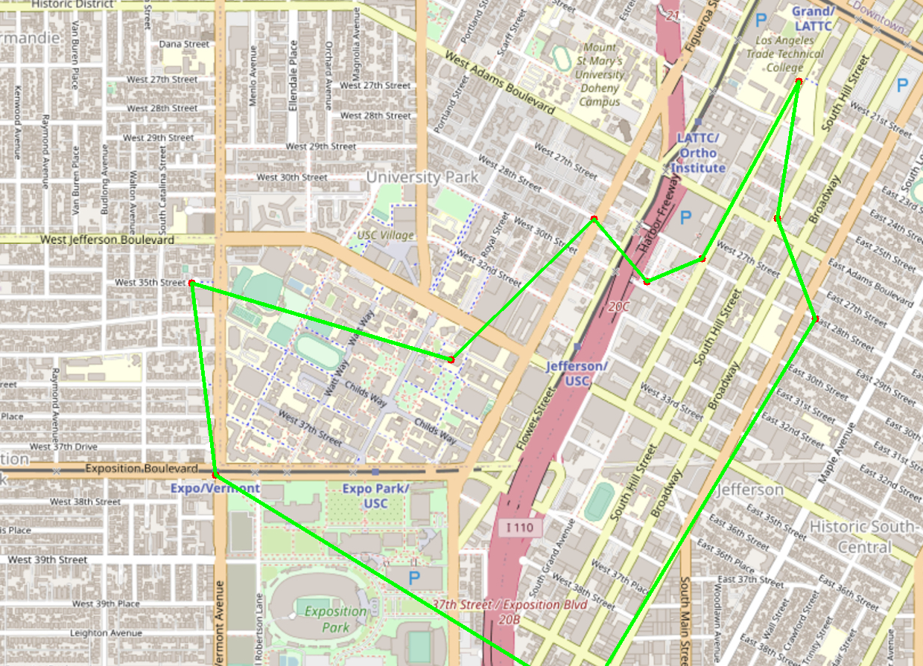
Generated Travelling Salesman Graph

Slide 13
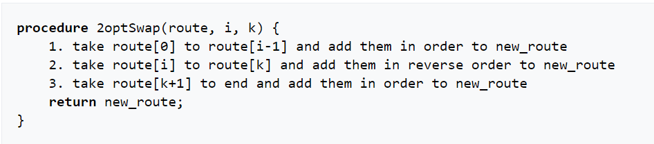
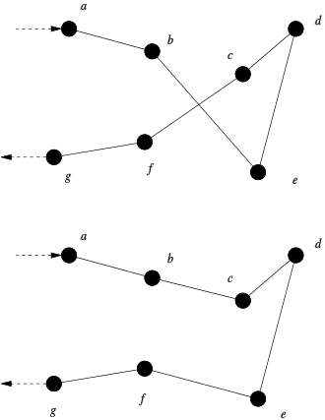
TRAVELLING Trojan(2-Opt heuristic)
Returning Position (Latitude and Longitude) for a given Nodes
This method is a heuristic one as we keep swapping the nodes till the time there is no improvement.
The time complexity is: O(n^2)
Time taken of large sets of input locations is very less compared to that of brute force.
Ref: https://en.wikipedia.org/wiki/2-opt

Slide 14
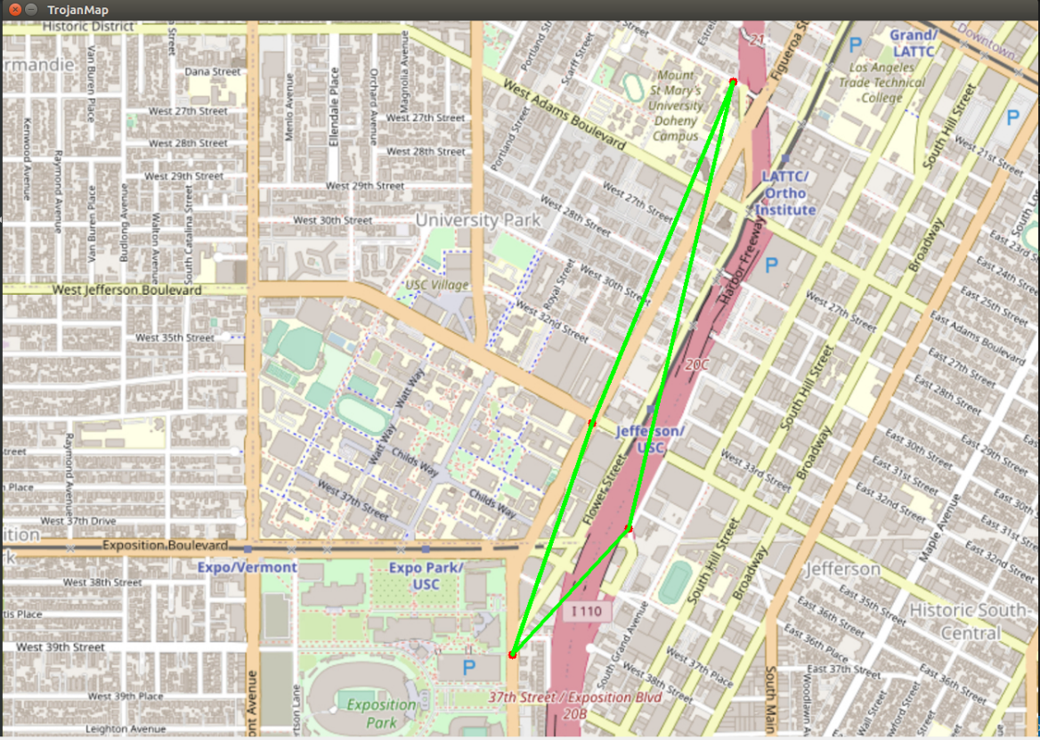
TRAVELLING tROJAN(output – 2_Opt heuristic)
Below is the output of our one such implementation with number of locations as ‘4’.

Slide 15
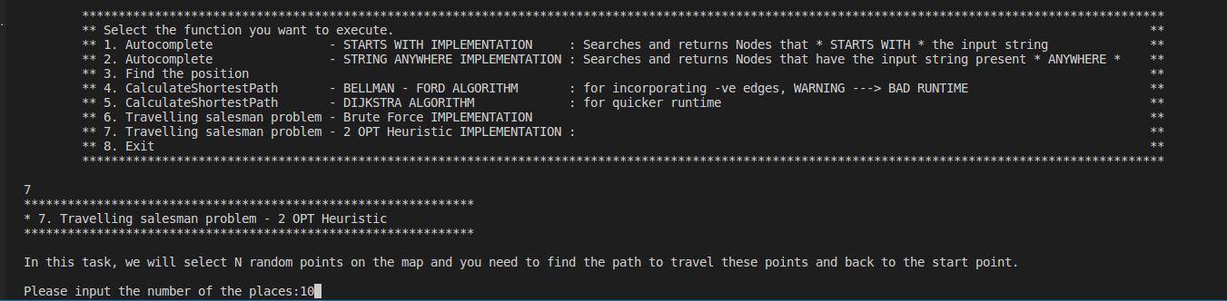
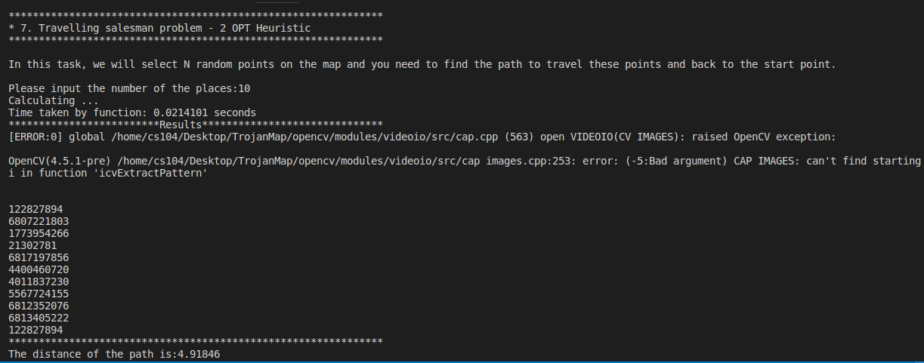

Slide 16
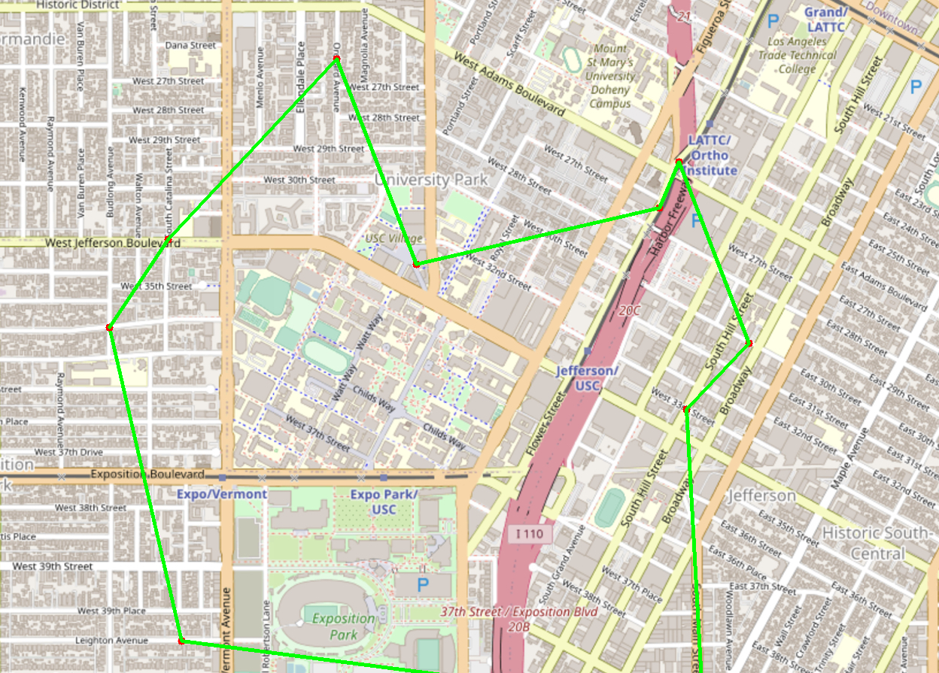
Generated Travelling Salesman Graph

Slide 17
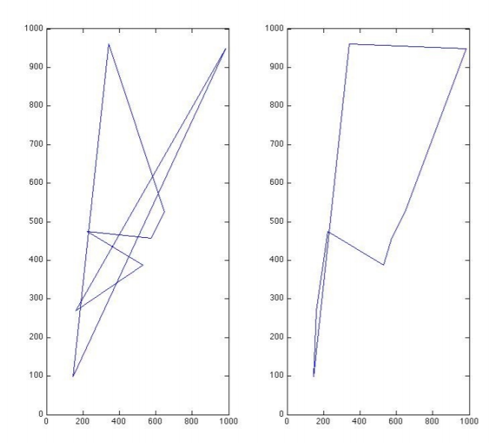
TRAVELLING Trojan(Comparison: Brute force vs 2_opt)
Returning Position (Latitude and Longitude) for a given Nodes
Ref: http://cs.indstate.edu/~zeeshan/aman.pdf

Slide 18
Comparison:
Shortest Path – Bellman Ford | 127 sec
Shortest Path – Dijkstra Algorithm | 0.2 sec
Travelling Trojan – Brute Force | 0.314 sec
Travelling Trojan – 2 OPT | 0.02 sec

Slide 19

Thank You
SAFE together
TROJAN FAMILY
WE FIGHT
AS ONE

